Slide 1
Project on Employee Attendance System
BALLARI INSTITUTE OF TECHNOLOGY AND MANAGEMENT
Ankita S 3BR23A1011
Arpitha BN 3BR23AI012
Jyothika 3BR23AI063
Jyothi 3BR23AI062
G.Aruna 3BR23AI043

Slide 2
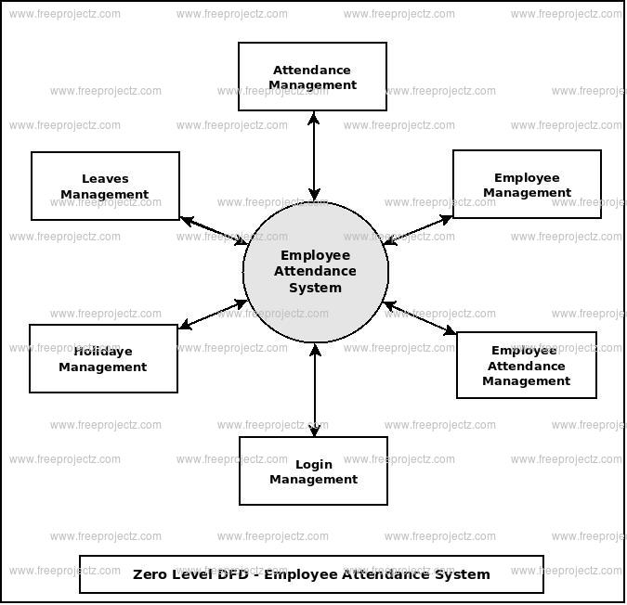
Introduction
An employee attendance system is a tool used by organizations to track the presence or absence of employees during working hours. It helps businesses monitor the attendance patterns of their employees, manage work schedules, calculate payroll and ensure compliance with labor laws.

Slide 3
PROBLEM STATEMENT
Attendance Management System is software developed for daily student attendance in schools, colleges and institutes. It facilitates to access the attendance information of a particular student in a particular class. This system will also help in evaluating attendance eligibility criteria of a student. By just a click on the mouse, the system will be able to produce the students' attendance report thus reducing the need for manual labour which is prone to human errors and time consuming.

Slide 4
OBJECTIVES
1.User-Friendly Interface: Easy navigation for employees to clock in/out, request leave, and view attendance history.
2. Mobile Accessibility: Allow employees to clock in/out and access attendance data via mobile devices.
3. Integration: Seamlessly integrate with existing HR, payroll, and time-off management systems.
4. Leave Management: Automate leave approval workflows and track leave balances.
5. Customizable Settings: Allow administrators to configure attendance policies, rules, and notifications.

Slide 5
PURPOSE
Improve productivity and engagement
Reduce administrative burdens
Control costs and compliance risks
Track attendance
Centralize employee data

Slide 6
MODULES
Administrative module:
Admin can add new employee
Admin can see the list of employee details
Only admin can edit the record of the employee
Admin will be able to delete the records of the employee
Admin can add employee attendance details
Edit the existing employee attendance details
View all the details of the employee attendance

Slide 7
Advantages and Disadvantages:
Advantages:
Time and cost efficiency
Data and analytics
Employee accountability
Remote and flexible work monitoring
Disadvantages:
Cost
Technical issues
Employee resistance
Dependence on technology

Slide 8
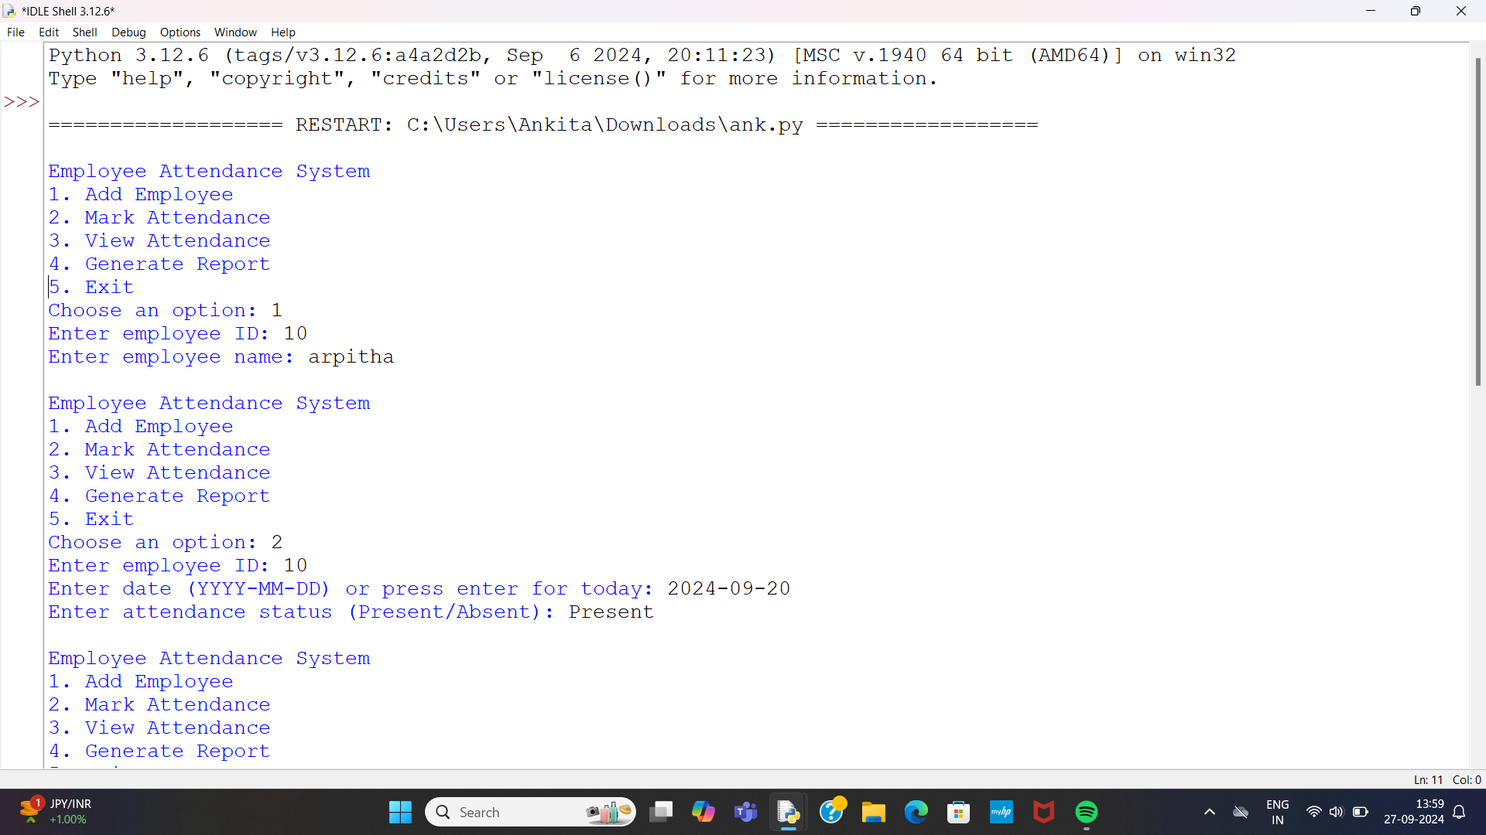

Slide 9
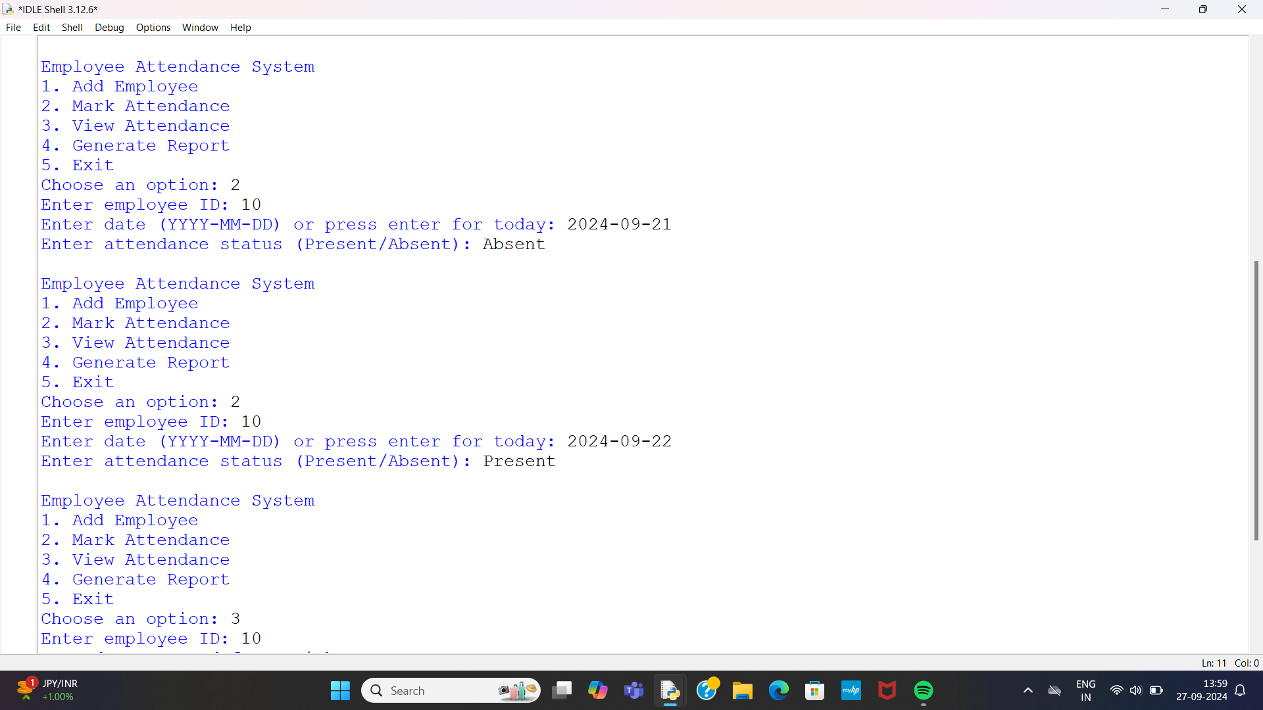

Slide 10
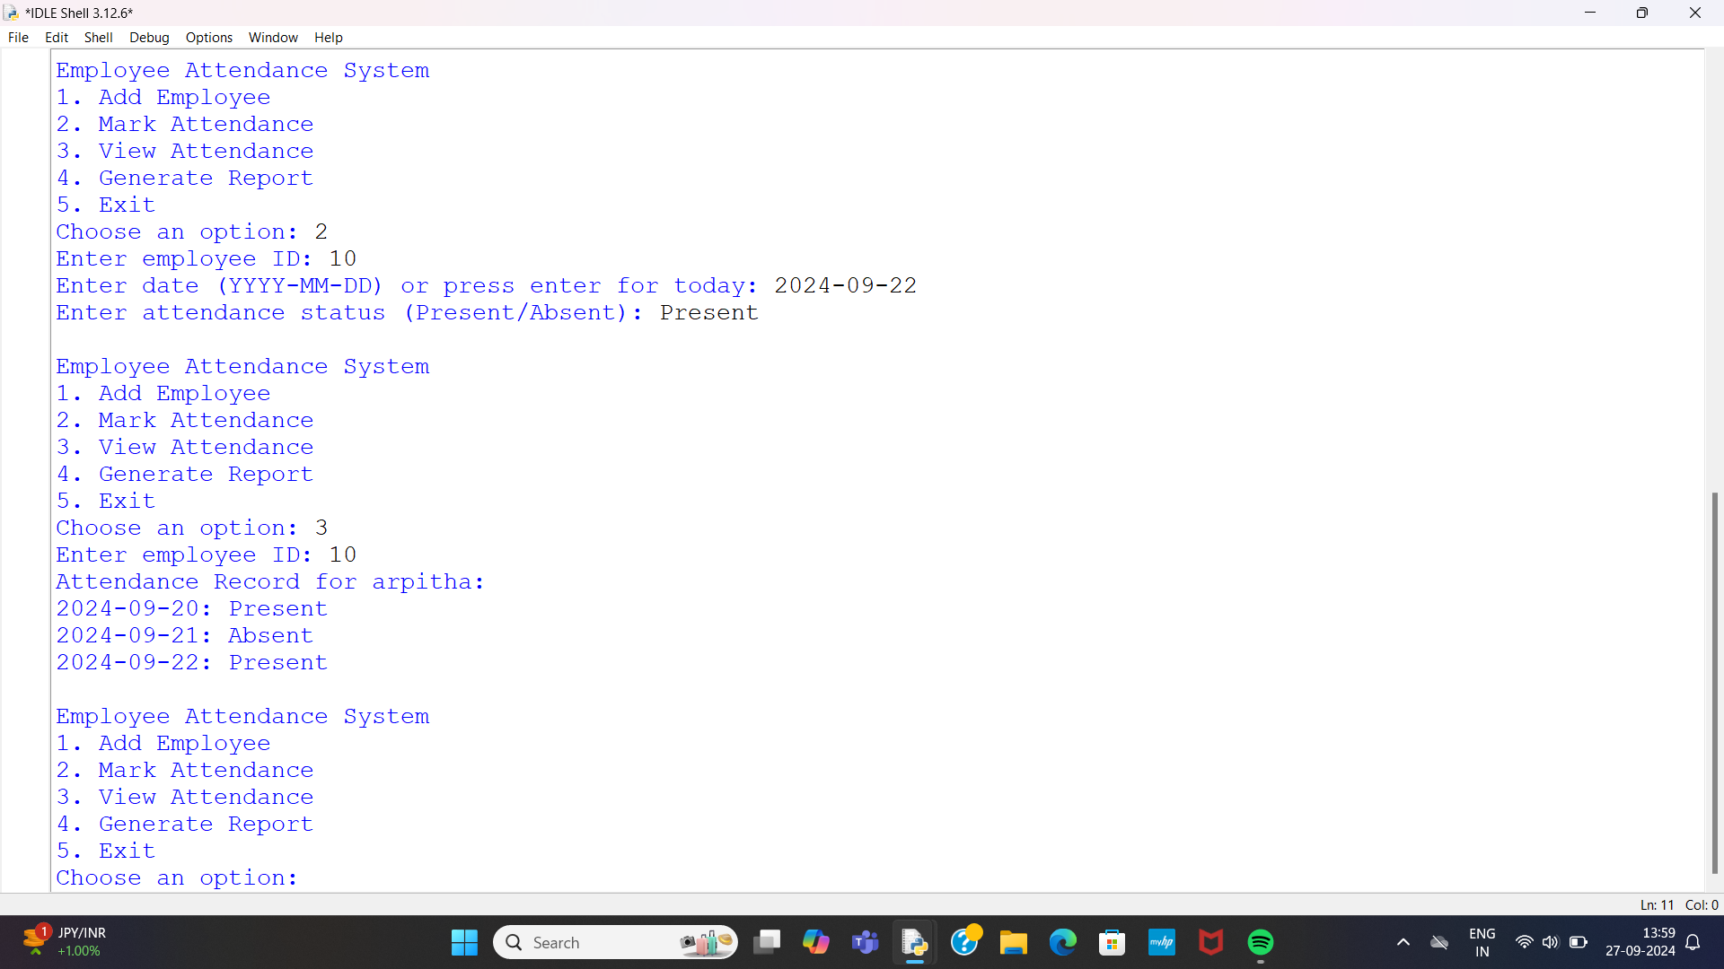

Slide 11
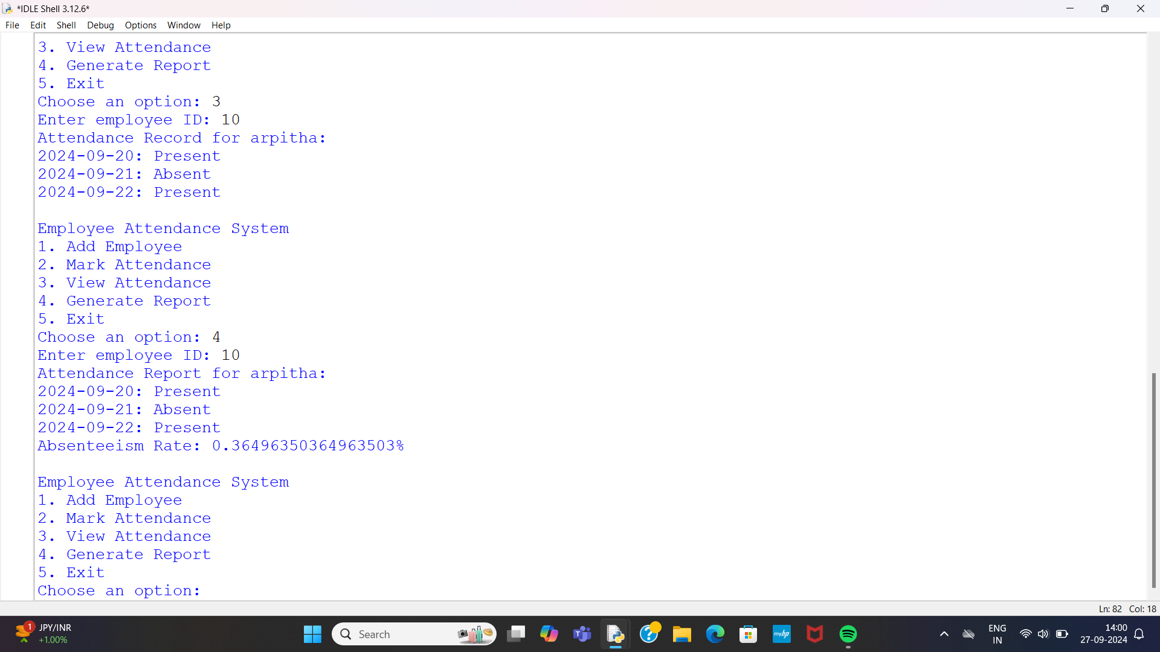

Slide 12
CONCLUSION
The project entitled ” Online Employee Attendance Management system ” is developed using HTML , CSS AND Bootstrap as front end and Python language and Sqlite database in back end to computerize the process of online attendance management of employees. This project covers only the basic features required.

